Slide 1
When to tell and when not to tell: Arbitrary and Necessary
Dave Hewitt

Slide 2
If I’m having to remember…
… then I’m not working on mathematics.

Slide 3
Pimolitel

Slide 4
Katie was about 4 years old when her mother, Barbara, mentioned New York whilst talking to someone else.
Katie: Where is New York?
Barbara: In the United States.
Katie: Why?

Slide 5
Student: What is the name of a four-sided shape which has all four angles equal to 90 degrees and all sides the same length?
Teacher: A square.
Student: Why?

Slide 6
Caleb Gattegno said:
… there is knowledge that is distinguished sharply from awareness - the knowledge solely entrusted to one’s memory, such as the label for such an object or a telephone number, items which are arbitrary. Without someone else, that knowledge would not exist for us (p55).
Gattegno, C. (1987), The Science of Education. Part 1 ‑ Theoretical Considerations, New York: Educational Solutions.

Slide 7
As you can tell, there must be 360 degrees in a whole turn!
The way a whole turn is divided is just a social convention.

Slide 8
Ginsburg gave a transcript of a conversation with a second grader, Kathy:
I: Why do you write a 13 like that, a 1 followed by a 3?
K: ‘Cause there’s one ten, right? So you just put 1. I don’t know why it’s made like that. They could put ten ones and a three. So you see 13 is like ten and a three, but the way we write it, it would be 103 so they just put 1 for one ten and 3 for the extra three that it adds on to the ten. (p116).
Ginsburg, H. (1977), Children's Arithmetic. The Learning Process, New York: D. Van Nostrand Company.

Slide 9
At the beginning of a lesson, I asked the class to give me properties that a square possessed. I got the following:
Parallel lines
Sides of equal length
Four right angles
I asked whether a shape with these properties HAD to be a square.
Could anyone draw a shape with these properties which was not a square?
One lad thought he could and came up and drew the following:

Slide 11
Memory
‘Glue’
Name
Properties and relationships
Arbitrary

Slide 12
The necessary…
What can you tell me about this shape? There are things you can say, and justify are true

Slide 13
360 degrees
There are in a whole turn
2π radians
Arbitrary
Necessary
π radians
There are in a half turn
180 degrees
Arbitrary

Slide 14
1, 2, 3, 4, 5, 6, 7, …
and
2 + 3 = 5
4, 1, 8, 7, 2, 9, 3, …
and
1 + 8 = 2
What is arbitrary and what is necessary?

Slide 15
Memory
Awareness
‘Glue’
Name
Properties and relationships
Arbitrary
Necessary

Slide 16
Arbitrary | All students need to be informed of the arbitrary by someone else | Realm of Memory
Necessary | Some students can become aware of what is necessary without being informed of it by someone else | Realm of Awareness

Slide 17
Cannot be worked out (might be so) | Can be worked out (must be so)
Summarised as: words, symbols, notation and conventions. | Summarised as: properties and relationships.
Consider items in the mathematics curriculum and decide which column they should go in.

Slide 18
Cannot be worked out (might be so) | Can be worked out (must be so)
Names of shapes Definitions of ...... Measuring bearings from north x and y co-ordinates How heavy is a kg? How long is a metre? Terminology - e.g. names of theorems, such as ‘factor’ theorem Word/label | Interior angles of regular polygons V = IR → I = V/R Solution of a linear equation What happens to a number if multiplied by <1 or >1 Rough estimates of measurements 2 x 3 Finding factors of a³ + b³ Finding angles or lengths in triangle problems, for example based upon this triangle: Property of primeness Symmetry
Summarised as: words, symbols, notation and conventions. | Summarised as: properties and relationships.

Slide 19
 | Student | Teacher | Mode of teaching
Arbitrary | All students need to be informed of the arbitrary by someone else | A teacher needs to inform students of the arbitrary | Assisting Memory
Necessary | Some students can become aware of what is necessary without being informed of it by someone else | A teacher does not need to inform students of what is necessary. Instead a teacher might use questions or provide activities | Educating Awareness

Slide 20
In a lesson I observed, some 14-15 year olds were working on solving simultaneous equations, and one male student was having difficulties with re-arranging an equation. He had written:
x - y = 2
y = 2 – x
I asked him about the ‘-’ sign in front of the y and his response was to re-write the second equation to:
y = 2 + x
I said that I felt he had done the correct thing when taking away the x but that there was still a ‘-’ sign in front of the y. I wrote a ‘-’ in front of the y in the original second equation:
- y = 2 – x
He then changed both the subtractions to additions saying two negatives make a positive:
+ y = 2 + x

Slide 21
Context
Context
Teacher
Student
“Two negatives
make a positive”
“Two negatives
make a positive”

Slide 22
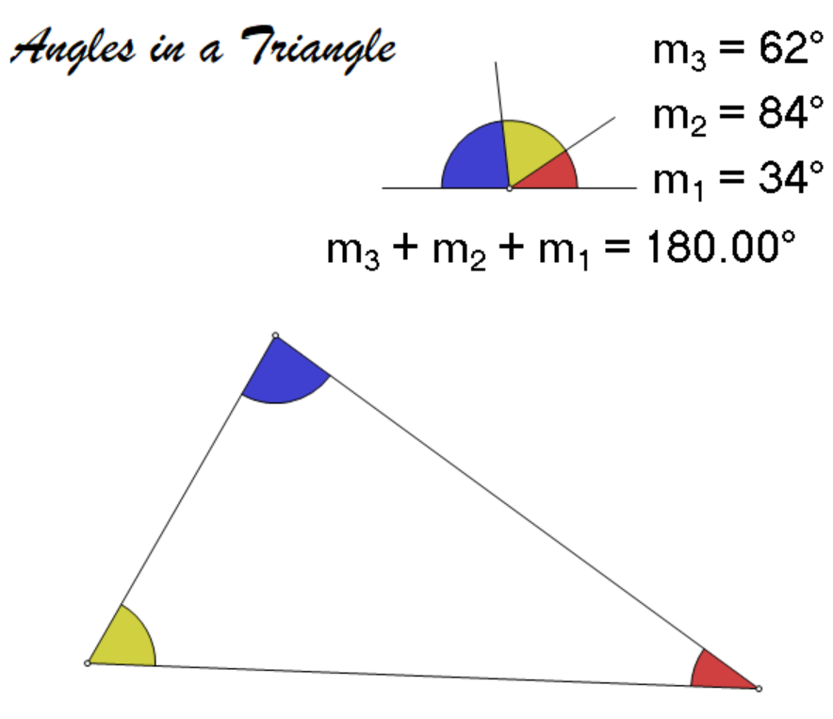
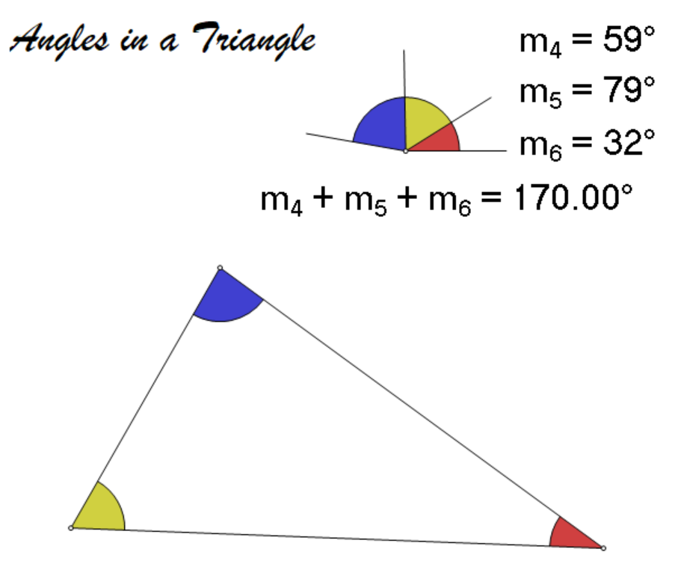
Angles inside a triangle
I showed a dynamic geometry file where the addition of angles always added to 180 degrees when the triangle was dynamically changed. However, I swapped to another file where the angles always added to 170. This was to show that despite the dynamic nature, students are still effectively being ‘told’ (by the computer) what the angles add up to.

Slide 23
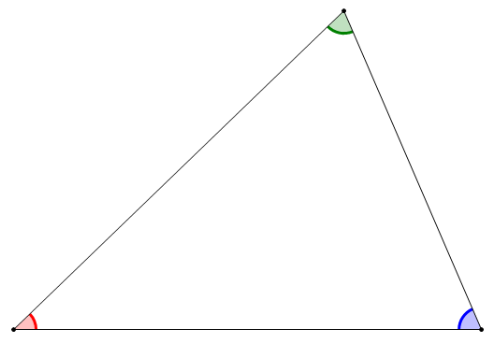

Slide 24
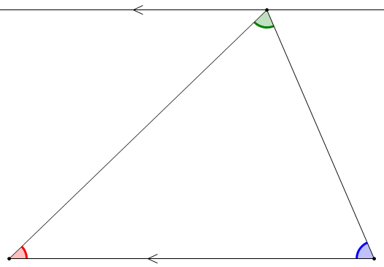

Slide 25
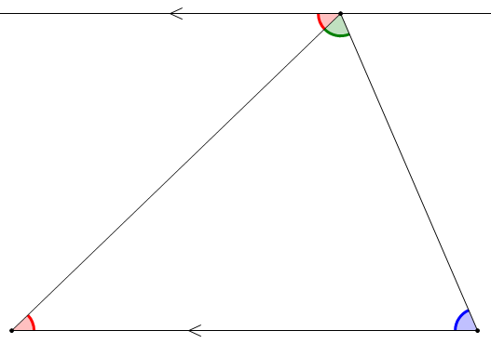

Slide 26
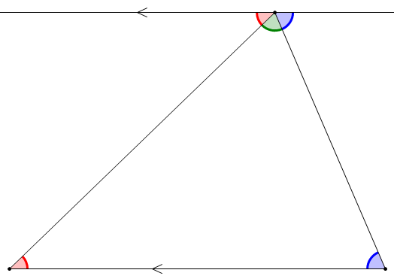

Slide 27
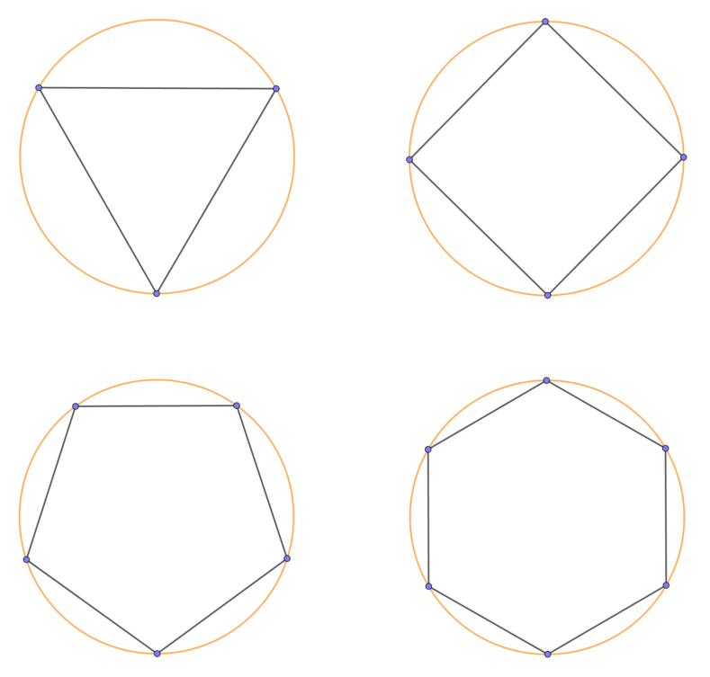
Unit circles

Slide 28
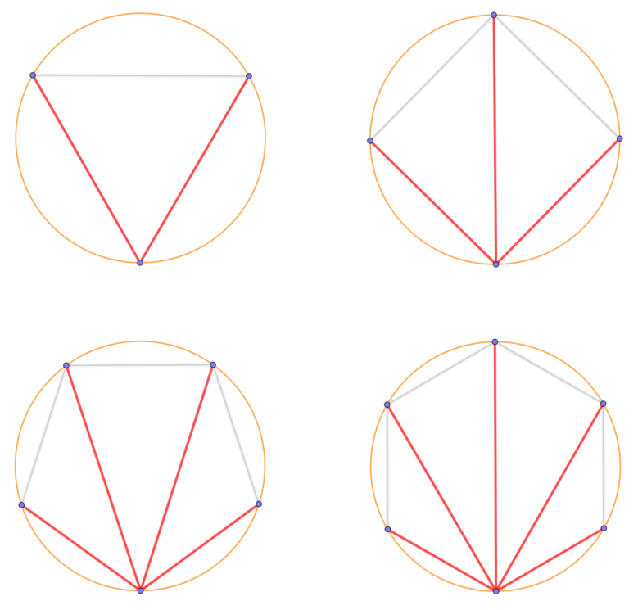
Unit circles:
For n points round the circle, multiplying the ‘diagonals’ from one vertex will result in ‘n’.

Slide 29
 | ARBITRARY |  | NECESSARY
TEACHER | teacher informs | teacher does not inform | teacher informs | teacher gives appropriate activity
STUDENT | students have to memorise | students have to invent | Received wisdom students - have to memorise unless they succeed in using their awareness to come to know | students - use awareness to come to know

Slide 30
Break

Slide 31
The Arbitrary: Assisting Memory

Slide 32
Walkerdine posed the question:
how do children come to read the myriad of arbitrary signifiers – the words, gestures, objects, etc. – with which they are surrounded, such that their arbitrariness is banished and they appear to have that meaning which is conventional? (p3)
Walkerdine, Valerie (1990) The Mastery of Reason: cognitive development and the production of rationality, London: Routledge.

Slide 33
What was the word I asked you to remember?
Pimolitel

Slide 34
Introducing the arbitrary

Slide 35
Learn the names

Slide 36
Drammer

Slide 37
Memory
Awareness
‘Glue’
Name
Properties and relationships
Arbitrary
Necessary

Slide 38
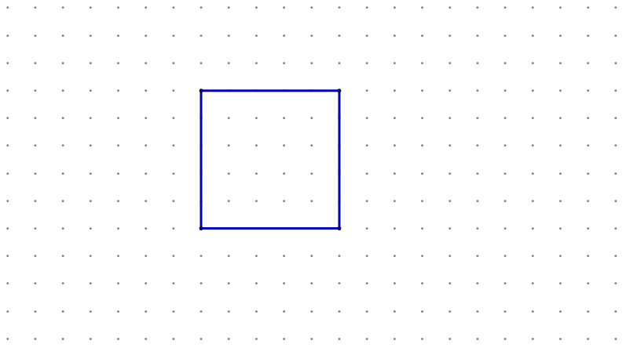
Drammer

Slide 39

Drammer

Slide 40
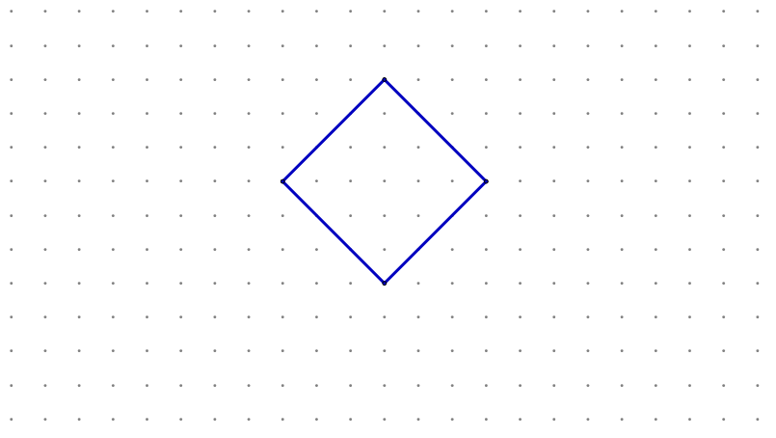
Drammer

Slide 41

Drammer

Slide 42
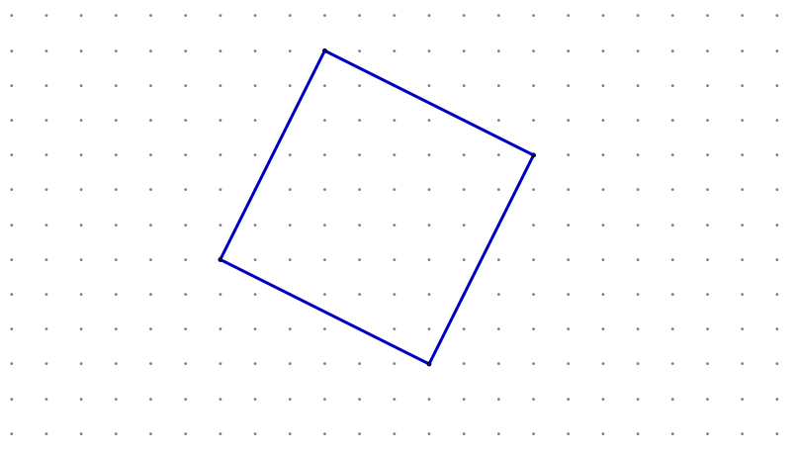
Drammer

Slide 43

NOT a Drammer

Slide 44
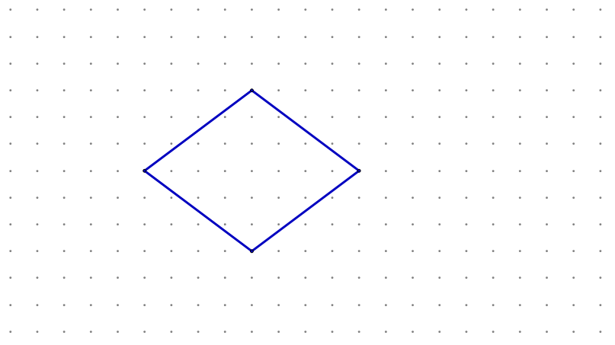
NOT a Drammer

Slide 45
Your turn to say….
Chant “Drammer”… or shout “no”!

Slide 46



Slide 47


Slide 48
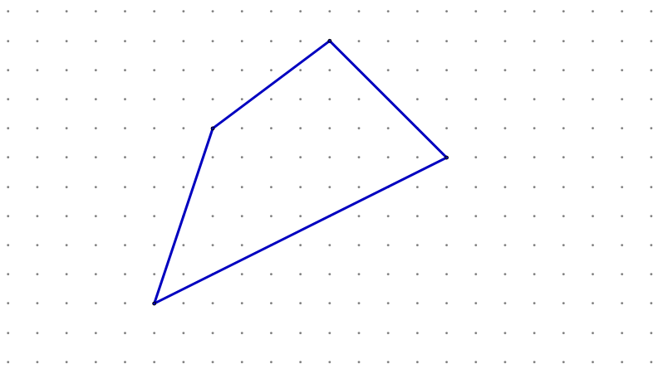

Slide 49
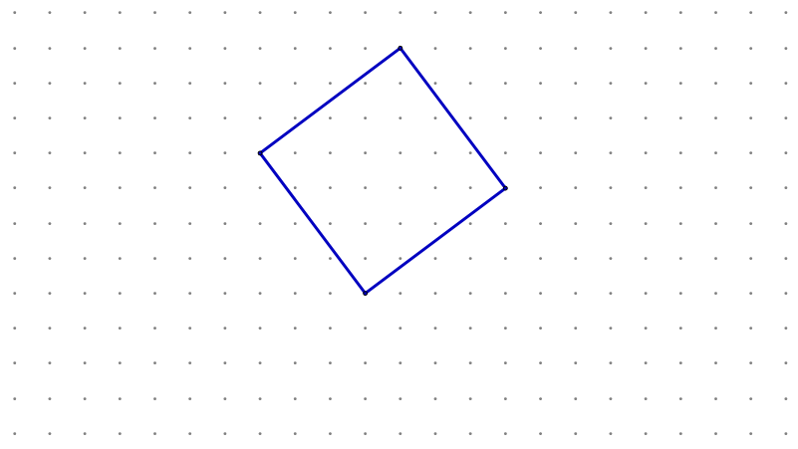

Slide 50


Slide 51
A new name…

Slide 52

Brosmal

Slide 53

Brosmal

Slide 54
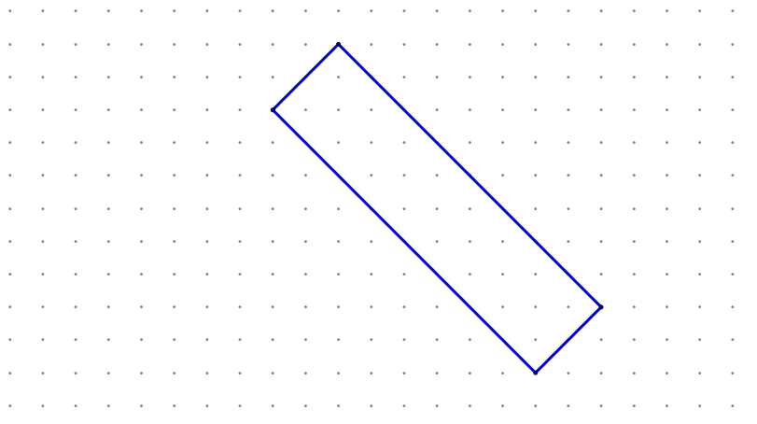
Brosmal

Slide 55

Brosmal

Slide 56
Brosmal

Slide 57
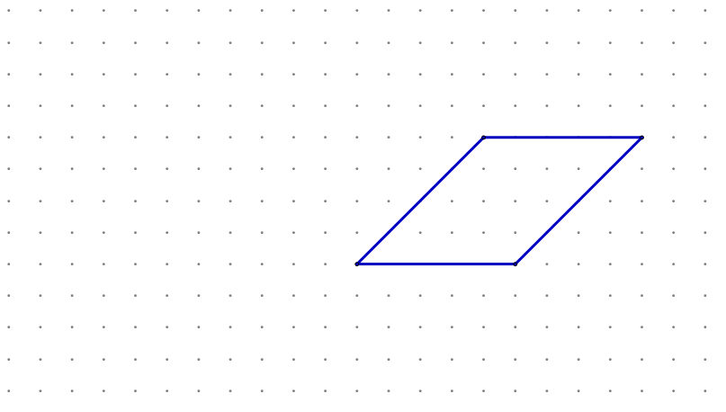
NOT a Brosmal

Slide 58

NOT a Brosmal

Slide 59
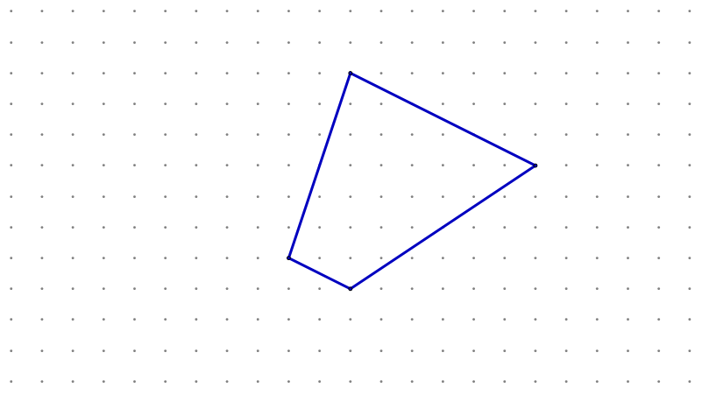
NOT a Brosmal

Slide 60
Your turn to say….
Chant “Brosmal”… or shout “no”!

Slide 61
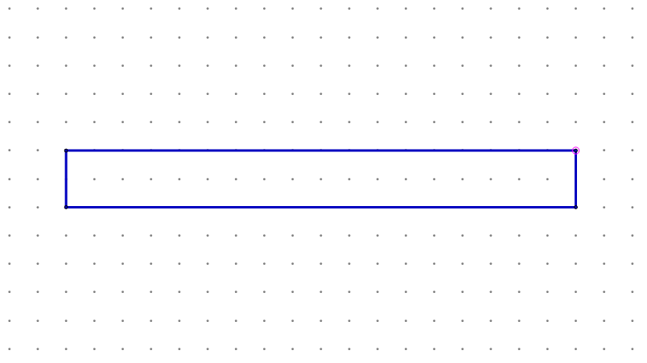

Slide 62
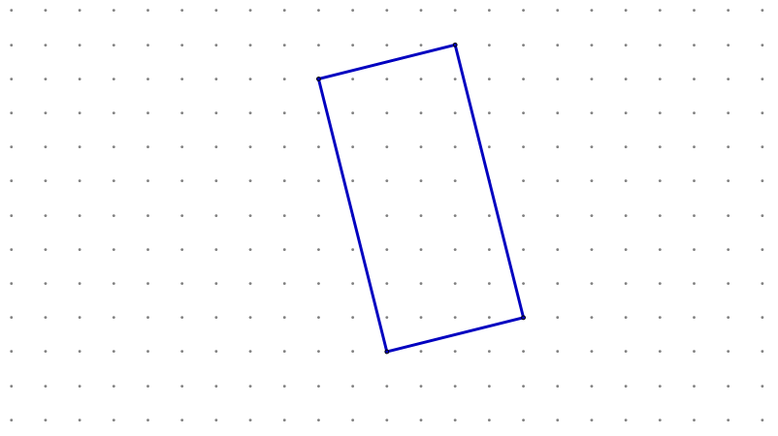

Slide 63
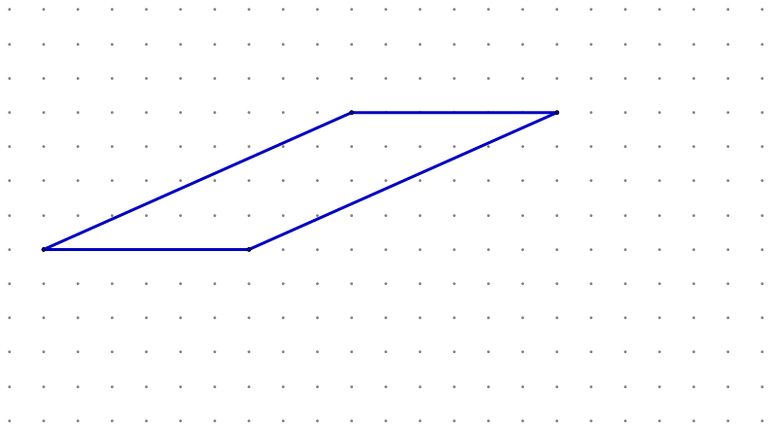

Slide 64
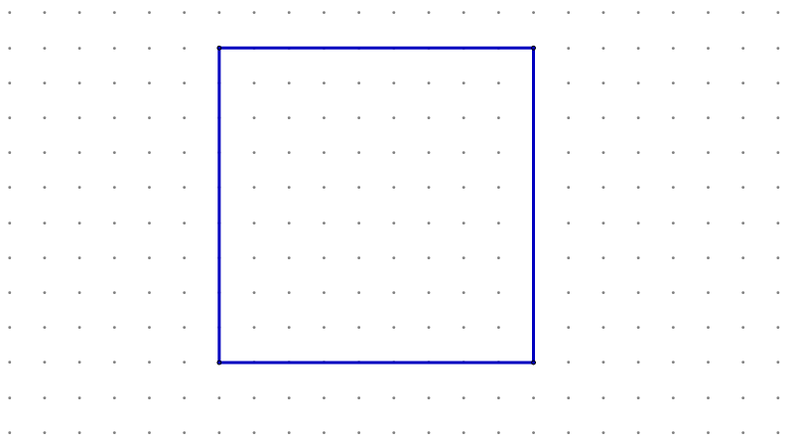

Slide 65
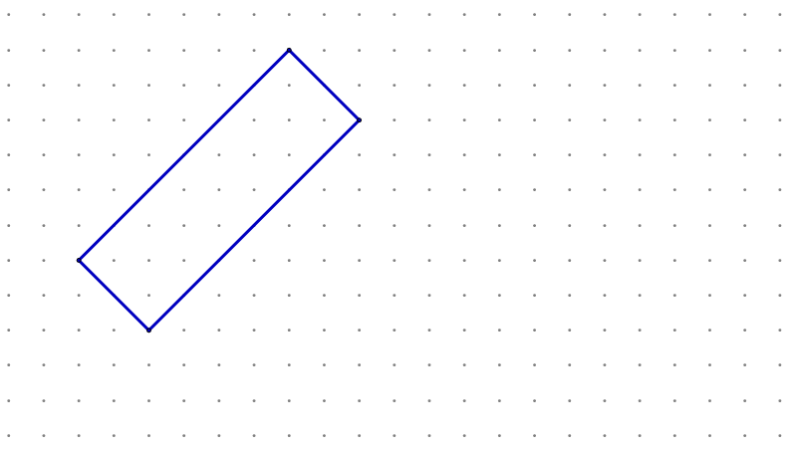

Slide 66
Your turn to say….
Chant “Brosmal” and/or “Drammer”…
or Shout “no”!

Slide 68
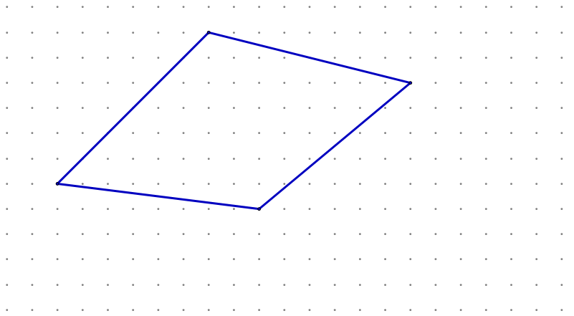

Slide 70
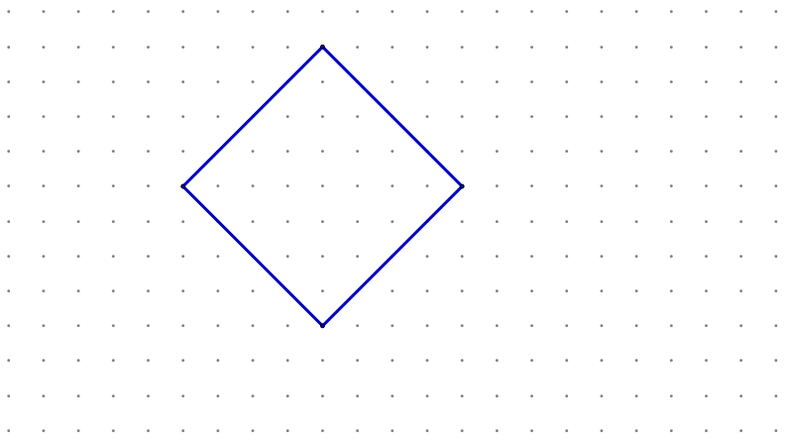

Slide 71
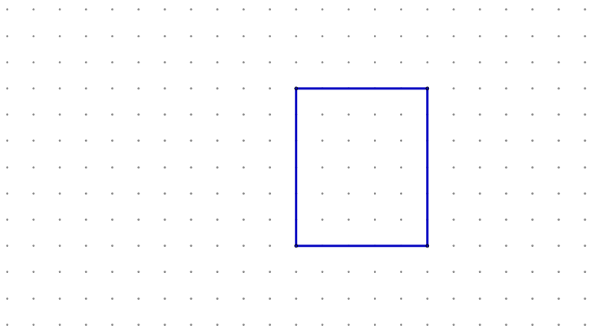

Slide 72
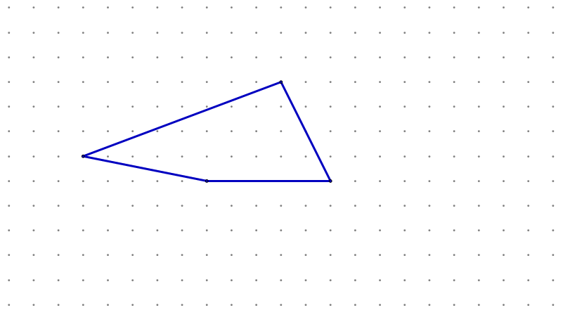

Slide 73
A new name…

Slide 74
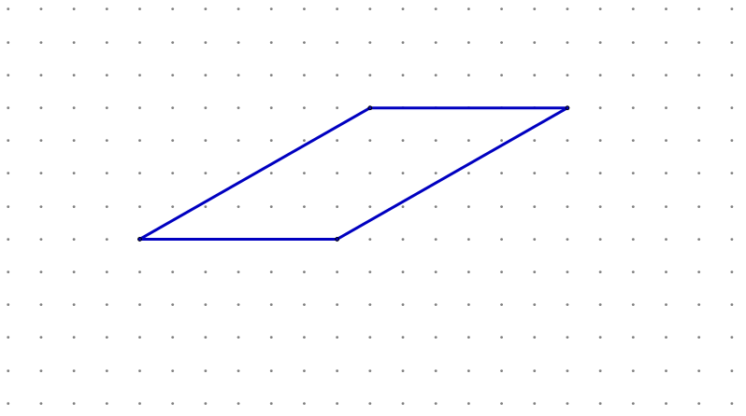
Tribble

Slide 75

Tribble

Slide 76

Tribble

Slide 77

Tribble

Slide 78
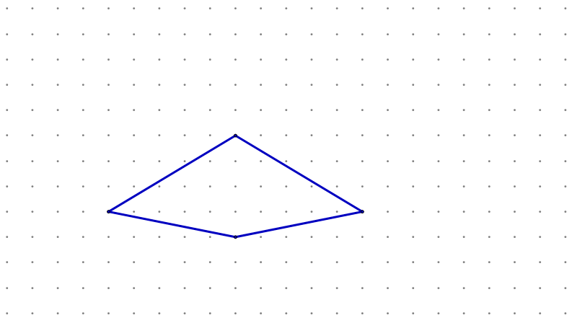
NOT a Tribble

Slide 79
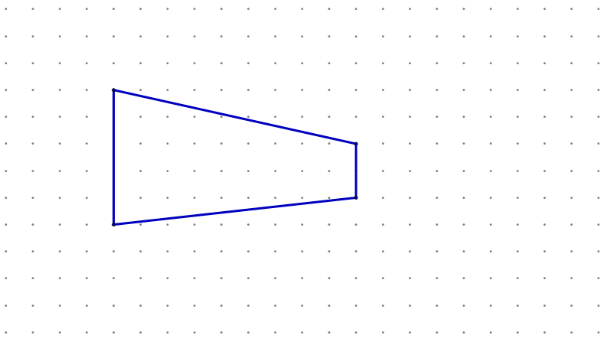
NOT a Tribble

Slide 80
Your turn to chant….
“Tribble”…
or shout “no”!

Slide 82
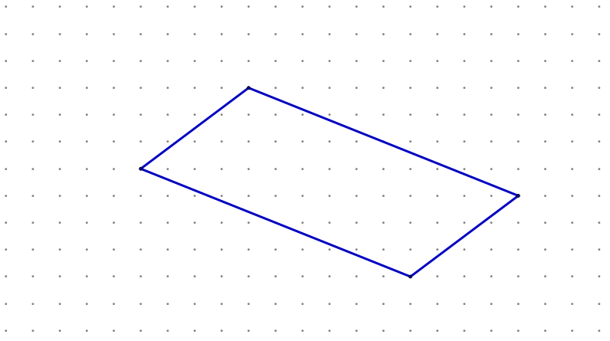

Slide 88
Your turn to chant….
“Tribble”, “Brosmal” and/or “Drammer”…
or shout “no”!

Slide 90
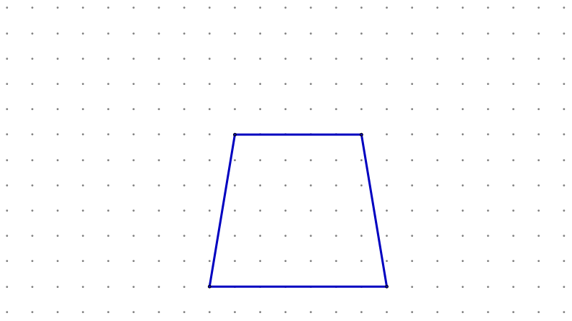

Slide 91
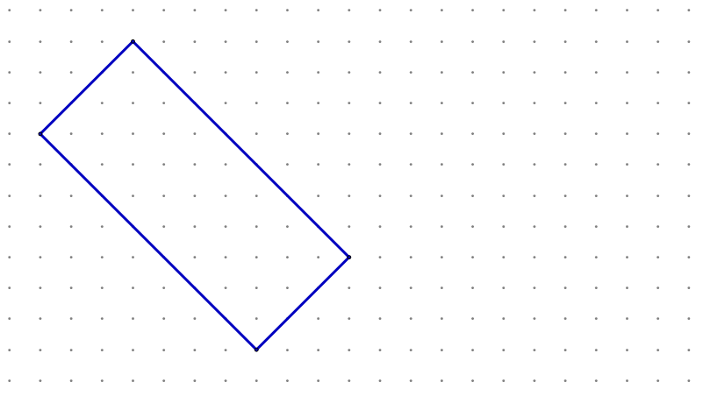

Slide 92
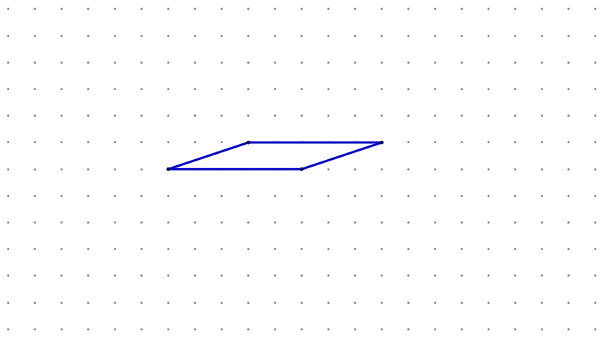

Slide 93
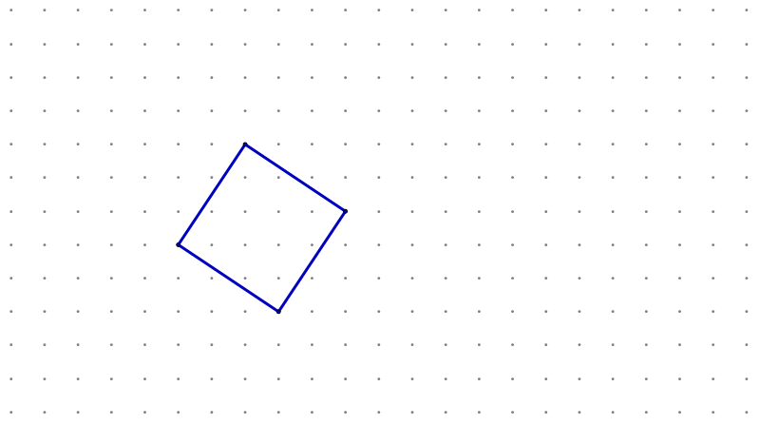

Slide 94


Slide 95


Slide 96
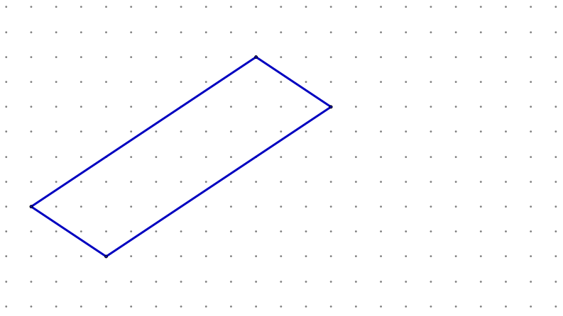

Slide 97
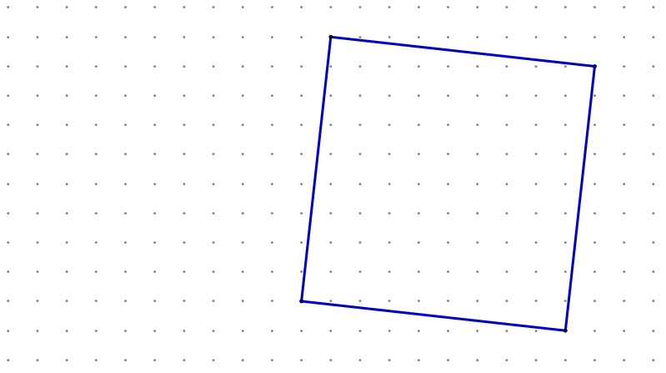

Slide 99
Practising the arbitrary

Slide 100

“Make some squares” game
10
Rules:
Two teams + one scribe
Each team in turn states a
Coordinate
(no pointing allowed)
The scribe puts a cross
(for one team) or a circle
(for the other team) at the
coordinate the team stated
Task:
Try to be the first team to have
their points at the corners of a
square.
First to have three squares
(on the same grid) wins.
9
8
7
6
5
4
3
2
1
0
0 1 2 3 4 5 6 7 8 9 10

Slide 101
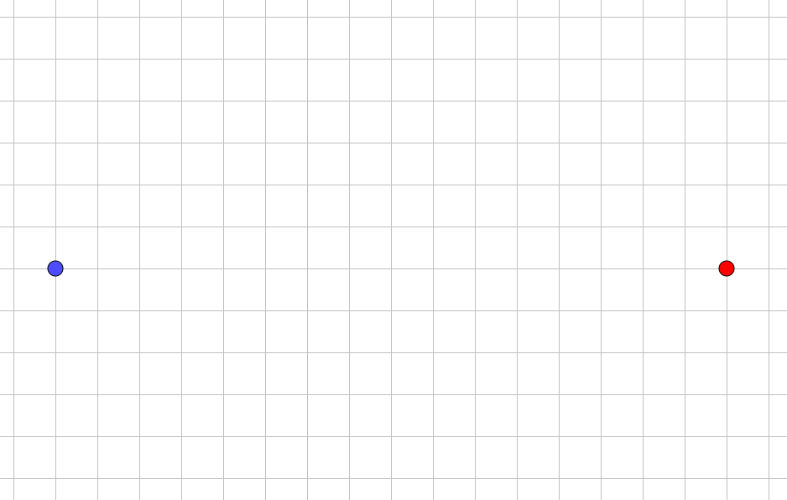
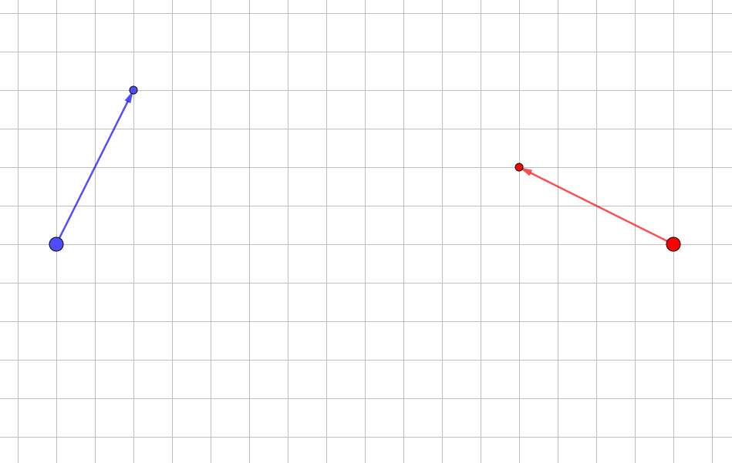
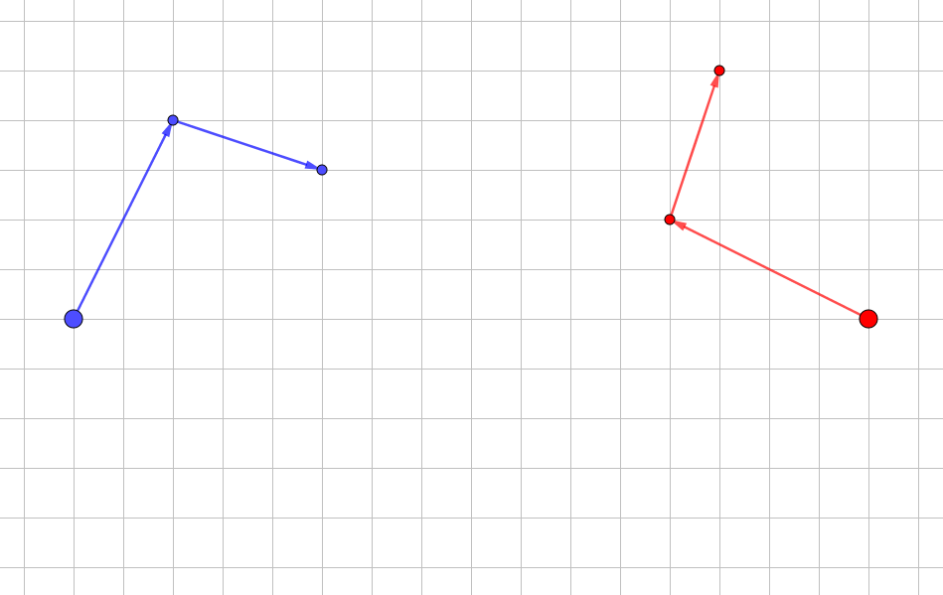
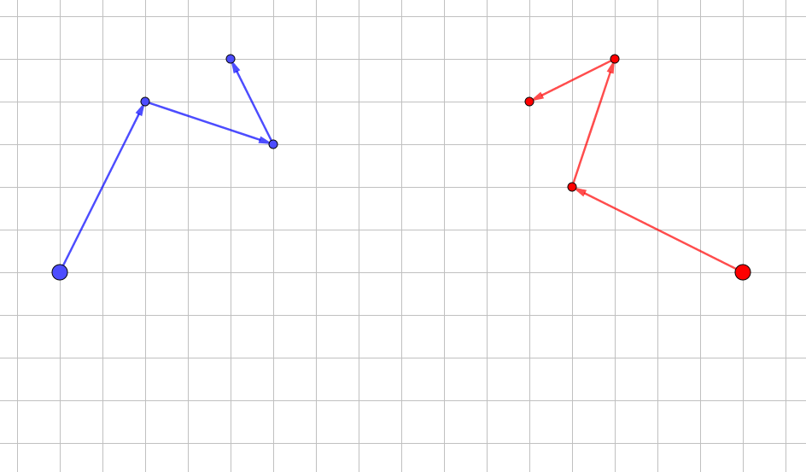
Do we meet?
Red starts by writing down a vector. A scribe then draws that vector from the red dot.
Blue moves according to a rule based on red’s move.
Task is for red to meet up with blue after a blue move.

Slide 102
Grid Algebra
To see information about the software:
Go to YouTube and search for Grid Algebra and Dave Hewitt
Software can be obtained from the Association of Teachers of Mathematics (ATM)
Single user:
https://www.atm.org.uk/shop/All-Products/Grid-Algebra---Single-User-Licence/sof071
Site licence:
https://www.atm.org.uk/shop/All-Products/Grid-Algebra---Site-Licence/sof074

Slide 103
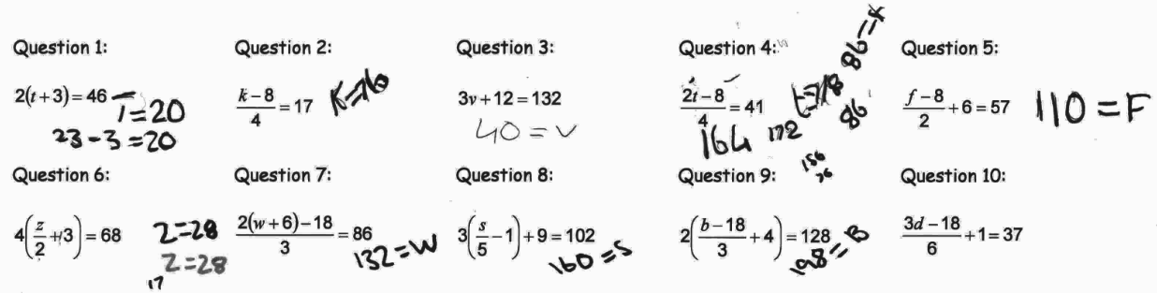
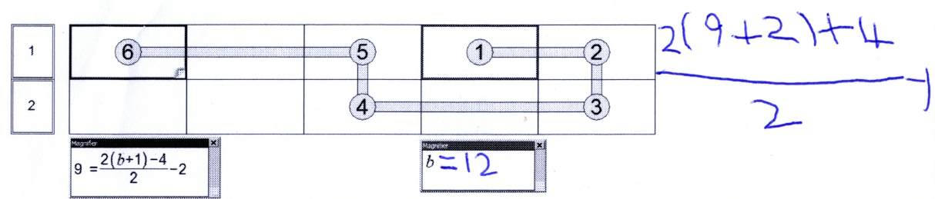
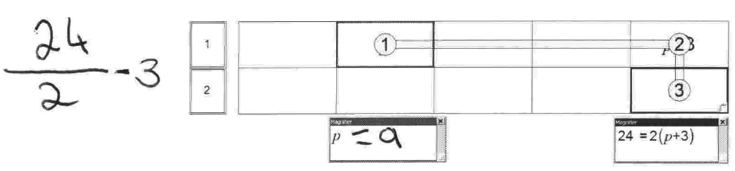
Grid Algebra
Year 5 mixed attainment class after 3 lessons.
Higher attainers at top and lower attainers at bottom.

Slide 104
Subordination
(Hewitt, 1996)
Student
Already know what they want to do
Challenge
Can recognise relative success
of attempts
Develop control/meaning
New notation

Slide 105
Break

Slide 106
The Necessary: Educating Awareness

Slide 107
The necessary
Teacher’s questioning
Student’s existing awareness
Activity
Desired mathematical properties or relationships

Slide 108
Becoming aware of what students are aware of…
Number line and fractions activity
(this was carried out with participants on the day)
Malcom Swan’s matching activities
Available from the STEM Centre (free but you have to register)
https://www.stem.org.uk/system/files/elibrary-resources/legacy_files_migrated/6517-S6.pdf
Get students talking and arguing!... (about the mathematics)

Slide 109

Educating awareness?
No, let me explain…
Teacher showing their own awareness of maths
Thinking and noticing
Making statements
Asking questions
Listening

Slide 110
Mathematical structure
20%
£72
30%
£108
75%
£270
8%
£28.80
25%
£90
10%
£36
100%
£360
17%
£61.20
1%
£3.60
50%
£180
n%
£360 _{x n}
^{100 ...}
5%
£18

Slide 111
What is going on?
Favourite times tables activity
This was an activity carried out on the day with participants.
It is written up in the following ATM publication:
Hewitt, D. (2018). Forcing awareness. In D. Brown, A. Coles & J. Ingram (Eds.), On teaching and learning mathematics with awareness (pp. 59-66). Derby: Association of Teachers of Mathematics.

Slide 112
Noticing
There is a difference between noticing patterns
and accounting for this patterns.
Notes:
OU: Expressing Generality : Project Mathematics

Slide 113
Accounting for what is noticed
1 | 2 | 3 | 4 | 5 | 6
7 | 8 | 9 | 10 | 11 | 12
13 | 14 | 15 | 16 | 17 | 18
19 | 20 | 21 | 22 | 23 | 24
25 | 26 | 27 | 28 | 29 | 30
31 | 32 | 33 | 34 | 35 | 36
37 | 38 | 39 | 40 | 41 | 42
43 | 44 | 45 | 46 | 47 | 48
49 | 50 | 51 | 52 | 53 | 54
55 | 56 | 57 | 58 | 59 | 60
61 | 62 | 63 | 64 | 65 | 66
67 | 68 | 69 | 70 | 71 | 72
73 | 74 | 75 | 76 | 77 | 78
79 | 80 | 81 | 82 | 83 | 84
85 | 86 | 87 | 88 | 89 | 90

Slide 114
Accounting for what is noticed
1 | 2 | 3 | 4 | 5 | 6
7 | 8 | 9 | 10 | 11 | 12
13 | 14 | 15 | 16 | 17 | 18
19 | 20 | 21 | 22 | 23 | 24
25 | 26 | 27 | 28 | 29 | 30
31 | 32 | 33 | 34 | 35 | 36
37 | 38 | 39 | 40 | 41 | 42
43 | 44 | 45 | 46 | 47 | 48
49 | 50 | 51 | 52 | 53 | 54
55 | 56 | 57 | 58 | 59 | 60
61 | 62 | 63 | 64 | 65 | 66
67 | 68 | 69 | 70 | 71 | 72
73 | 74 | 75 | 76 | 77 | 78
79 | 80 | 81 | 82 | 83 | 84
85 | 86 | 87 | 88 | 89 | 90

Slide 115
Pythagoras

Slide 116
c
a
b

Slide 118
c
a
b

Slide 119
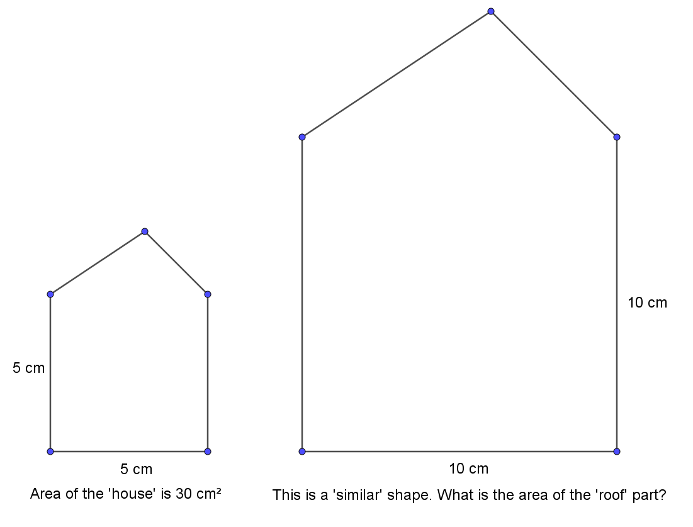

Slide 120
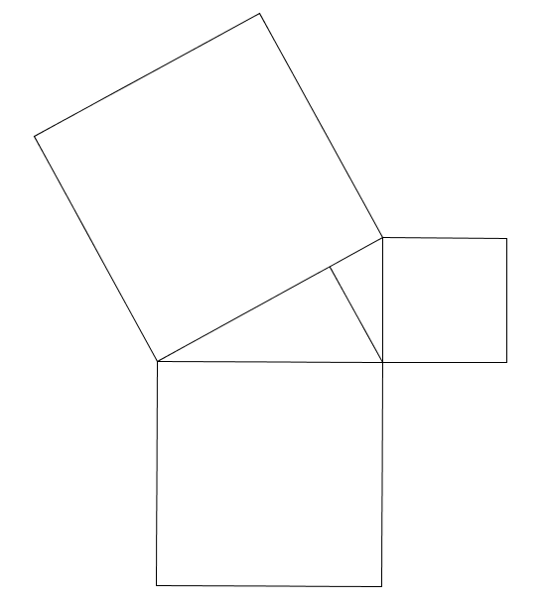

Slide 121
Directing attention
Year 8 top set student was trying to solve:
He had got to the following and was stuck:
I covered up the 10x and asked what number was under my finger.

Slide 122
Scenarios
A list of scenarios was given out where the task is to consider:
What you would state
What questions you would ask
How you might direct attention to certain aspects
Etc…
… whilst being sensitive to the notion of only telling students those things which are arbitrary.

Slide 123
If I’m having to remember…
… then I’m not working on mathematics.

Slide 124
Thank you

