Slide 1
Learner difficulties with algebra: are they really about algebra and do they really have to be difficult?
Dave Hewitt
Loughborough University

Slide 2
A question
What difficulties do school students really have with algebra?

Slide 3
My answer
I don’t know

Slide 4
Task 1
Solve the following equation for x showing written versions of steps you made (even if they were steps mentally carried out)

Slide 5
Some well known difficulties
The equals sign and the process-object dichotomy
Letters and formal notation

Slide 6
Equals sign
Indication to carry out an operation (Sfard & Linchevski, 1994; Sáenz-Ludlow, A. and Walgamuth, C.,1998).
Statement such as 7 + 8 = □ + 9 was answered by most throughout years as either 15 or 24. No significant change over the three years (Year 3 to Year 5). (Warren, 2003).
Middle school students’ understanding of the equals sign is associated with performance on equation-solving tasks (holds after controlling for mathematical ‘ability’). (Knuth et al., 2006)
Children’s equation learning difficulties are due, at least in part, to their early and elongated experience with arithmetic operations (McNeil & Alibali, 2002)

Slide 7
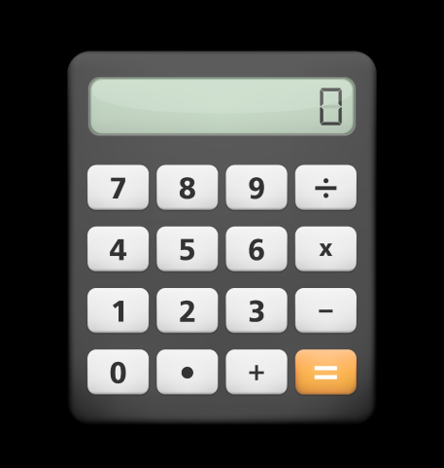
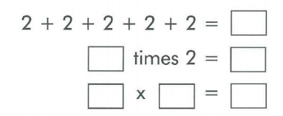
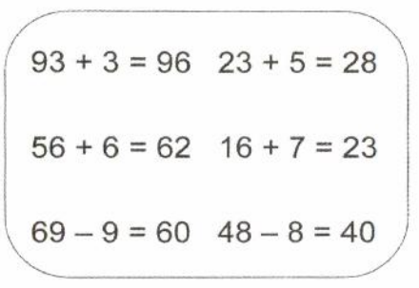
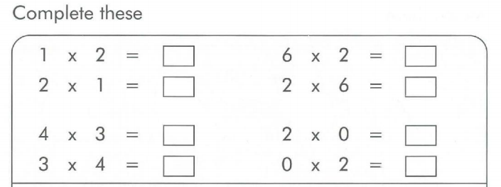
Equals sign

Slide 8
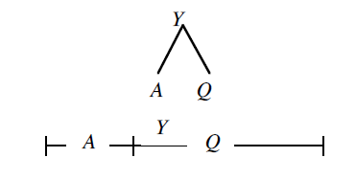
Equals sign - Davydov approach
“children physically compare objects’ attributes (such as length, area, volume, and mass), and describe those comparisons with relational statements like G < R. The letters represent the quantities being compared, not the objects themselves. It is important to note that the statements represent unspecified quantities that are not countable at this stage of learning.“ (Dougherty, B. J. and Zilliox, J., 2003, p. 18)
Y = A + Q Q + A = Y Y – Q = A Y – A = Q

Slide 9
Equals sign
Operational understanding
Relational understanding
Substitutive understanding (Jones & Pratt, 2012)

Slide 10
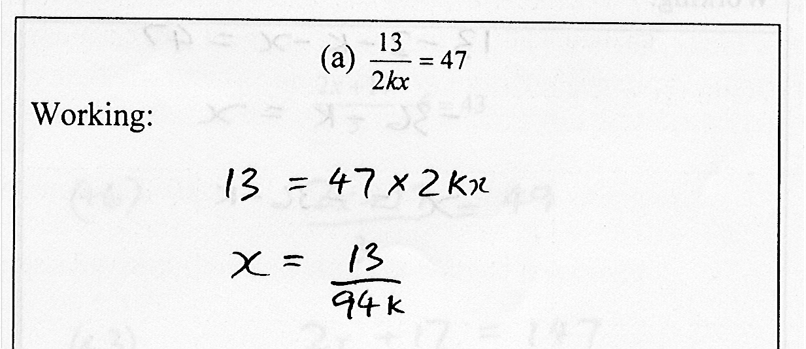
Equals sign
49 out of 80 teachers had the x appearing on the LHS (Hewitt, 2003)

Slide 11
Process/Object
Process - product dilemma (Kieran, 1989)
Process - object dichotomy (Sfard & Linchevski, 1994)
Proceptual thinking (Gray & Tall, 1994)

Slide 12
Process over object

Slide 13
Process over object?
Gattegno (1963, p.78)

Slide 14
Working Arithmetically
and
Working Algebraically

Slide 15
What is it to work algebraically?

Slide 16
What is algebra?
Algebra as appearance of letters
Algebra as working with equations with a letter on both sides of the equation (Filloy & Rojano,1989)
Algebra as working with or on the unknown (Herscovics & Linchevski, 1994)
Algebra as an expression of generality mediated by actions, words and gestures (Radford, 2009)
Algebra as seeing the general in the particular and the particular in the general (Mason, 1996)
Algebra as an attribute of the mind: operations upon operations (Gattegno, 1988)

Slide 17
Gattegno’s definition
Attribute of the mind
Viewing algebraic activity more widely and not just within mathematics
Language

Slide 18
Language
“There are sheeps in the field.”
“I goed to the park yesterday.”

Slide 19
Working algebraically on number

Slide 20
Working algebraically on number
5 + 5
3 + 7
6 + 4
10

Slide 21
Working algebraically on number
5 + 5
(6–1) + (4+1)
(5-2) + (5+2)
3 + 7
6 + 4
10

Slide 22
Working algebraically on number
5 + 5
10 = (3+n) + (7-n)
(6–1) + (4+1)
(5-2) + (5+2)
(3+5) + (7-4)
3 + 7
6 + 4
(3-1) + (7+1)
(3+3) + (7-3)
10

Slide 23
Working algebraically on number
10 = 6 + 4
= 5 + 5
= 3 + 7
= …

Slide 24
Working algebraically on number
23 + 16
= 22 + 17
= 21 + 18
= 20 + 19
= 39
Use our algebraic awarenesses to transform one form into equivalent forms
We make choices about which forms are more useful to us given a particular context

Slide 25
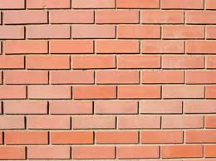
Arithmetic and algebra
Hewitt, D. (1998)
Algebra
Arithmetic

Slide 26
Notation

Slide 27
What is x?
Küchemann (1981, p104) identified six categories of letter usage (in hierarchical order):
Letter evaluated: the letter is assigned a numerical value from the outset;
Letter not used: letter is ignored, or at best acknowledged existence but without given meaning;
Letter as object: shorthand for an object or treated as an object in its own right;
Letter as specific unknown: regarded as a specific but unknown number, and can be operated on directly;
Letter as generalised number: seen as being able to take several values rather than just one;
Letter as variable: representing a range of unspecified values, and a systematic relationship is seen to exist between two sets of values.

Slide 28
Introduction of x
In a Year 8 class set 3 of 5:
x
One boy thought this was a drawing of
“a bloke with no head”
Notes:
The symbol itself seems to be a problem, let alone beginning to do something with it.

Slide 29
Notation
Teacher: “What have you put there?”
Pupil: “Put x three”
Teacher: “What should you have?”
Pupil: “Three x”
Teacher: “Exactly”
Teacher then takes the three 1s on LHS away
And replaced them with another two xs.
But I heard the pupil say “The other side”
Later on another pupil said of the LHS:
“We have three xs on that side”
x
x
x
1
1
1
1
=
1
1
1
1
1
1
x
1
1
1
=
1
1
1
1
1

Slide 30
Notation
(Yushau, 2016)

Slide 31
Notation

Slide 32
Learning notation

Slide 33
‘Looking at' versus 'looking through' symbols.

Slide 34
Repeated refined. Pedagogically shaped.
Mediated but raw representations
Mediated experience
B
A
Refined and more systematic representations
Mediated experience
A_{B}
C
More or less conventional representations
Mediated experience
D
A_{C}
…
(Kaput, Blanton & Moreno, 2008)

Slide 35
Arbitrary and Necessary
Arbitrary: socially agreed names and conventions
e.g. Isosceles triangle, 360 degrees, (x,y)
All students have to be informed
Necessary: properties and relationships
e.g. 2+3, angles inside triangle add up to half a whole turn in Euclidean Geometry, all quadrilaterals tessellate
Some students can come to know these without being informed
(Hewitt, 1999)

Slide 36
Think of a number

Slide 37
Subordination
(Hewitt, 1996)
Student
Already know what they want to do
Challenge
Develop control/meaning
New notation

Slide 38
‘Looking at' versus 'looking through' symbols.

Slide 39
Grid Algebra

Slide 40
Grid Algebra

Slide 41
Recommendations
Stop thinking about the transition from arithmetic to algebra
Instead start thinking about working algebraically on number
Arithmetic concerns the carrying out of operations
Algebra concerns the meta-level awarenesses gained from making the operations themselves the object of study
To work on the inherent structure of a problem: do not carry out any arithmetic, just write down what arithmetic you would do
Realise that many difficulties learners have with algebra are really about notation, not algebra
Notation is ‘arbitrary’
So teaching and learning notation is a different task to that of teaching and learning algebra
It requires learners to accept and adopt rather than question
It requires teachers to take care of the symbols (Tahta, 1989)
Subordinate the learning of notation to already known algebraic activity

Slide 42
Conclusions
Learner difficulties with algebra:
Are they really about algebra?
Not always
… and do they really have to be difficult?
Not always

Slide 43
References
Alibali, M. W., Knuth, E. J., Shanta, H., McNeil, N. M. and Stephens, A. C. (2007). A longitudinal examination of middle school students’ understanding of the equal sign and equivalent equations. Mathematical Thinking and Learning 9(3), pp. 221-247.
Bills, L., Ainley, J. and Wilson, K. (2006). Modes of algebraic communication - moving from spreadsheets to standard notation. For the learning of mathematics 26(1), pp. 41-47.
Brizuela, B. and Schliemann, A. (2004). Ten-year-old students solving linear equations. For the learning of mathematics 24(2), pp. 33-40.
Coles, A. and Sinclair, N. (2017). Re-thinking place value: from metaphor to metonym. For the learning of mathematics 37(1), pp. 3-8.
Dougherty, B. J. and Zilliox, J. (2003). Voyaging from theory to practice in teaching and learning: a view from Hawai'i. In N. A. Pateman, B. J. Dougherty and J. T. Zilliox (Eds), Proceedings of the 27th Conference of the International Group for the Psychology of Mathematics Education held jointly with the 25th Conference of PME-NA, (Vol. 1, pp. 17-23). Hawai'i, USA: PME.
Feynman, R. (1988) 'What do you care what other people think?'. London: Unwin Hyman.
Filloy, E. and Rojano, T. (1989). Solving equations, the transition from arithmetic to algebra. For the Learning of Mathematics 9(2), pp. 19-25.
Fujii, T. and Stephens, M. (2001). Fostering an understanding of algebraic generalisation through numerical expressions: the role of quasi-variables. In H. Chick, K. Stacey, J. Vincent and J. Vincent (Eds), Proceedings of the 12th Study conference of the International Commission on Mathematical Instruction: The Future of the Teaching and Learning of Algebra, (Vol. 1, pp. 258-264). Melbourne, Australia: The University of Melbourne.
Gattegno, C. (1963). Mathematics with numbers in colour: Book 1. Reading: Educational Explorers Lmited.
Gattegno, C. (1971). What we owe children. The subordination of teaching to learning. London: Routledge and Kegan Paul Ltd.
Gattegno, C. (1988). The science of education. Part 2b: the awareness of mathematization. New York: Educational Solutions.
Gray, E. M. and Tall, D. O. (1994). Duality, ambiguity and flexibility: A proceptual view of simple arithmetic. Journal for Research in Mathematics Education 25(2), pp. 115-141.

Slide 44
References
Herscovics, N. and Linchevski, L. (1994). A cognitive gap between arithmetic and algebra. Educational Studies in Mathematics 27, pp. 59-78.
Hewitt, D. (1994). The principle of economy in the teaching and learning of mathematics. Unpublished PhD dissertation. The Open University, Milton Keynes.
Hewitt, D. (1996). Mathematical fluency: the nature of practice and the role of subordination. For the Learning of Mathematics 16(2), pp. 28-35.
Hewitt, D. (1998). Approaching Arithmetic Algebraically. Mathematics Teaching 163, pp. 19-29.
Hewitt, D. (1999). Arbitrary and Necessary: Part 1 a Way of Viewing the Mathematics Curriculum. For the Learning of Mathematics, 19(3), 2-9.
Hewitt, D. (2003). Notational issues: visual effects and ordering operations. In N. A. Pateman, B. J. Dougherty and J. Zilliox (Eds), Proceedings of the 2003 Joint Meeting of the International Group for the Psychology of Mathematics Education (PME) and PME North America Chapter (PME-NA), Vol. 3, Honolulu, USA, College of Education, University of Hawai'i, pp. 63-69.
Hewitt, D. (2012). Young students learning formal algebraic notation and solving linear equations: are commonly experienced difficulties avoidable? Educational Studies in Mathematics 81(2), pp. 139-159.
Hewitt, D. (2015). The economic use of time and effort in the teaching and learning of mathematics. In S. Oesterle and D. Allan (Eds), Proceedings of the 2014 Annual Meeting of the Canadian Mathematics Education Study Group, (pp. 3-23). Edmonton, Canada: CMESG/GCEDM.
Hewitt, D. (2016). Designing educational software: the case of Grid Algebra. Digital Experiences in Mathematics Education 2(2), pp. 167-198.
Hughes, M. (1990). Children and Number. Difficulties in Learning Mathematics. Oxford: Basil Blackwell.
Jones, I. and Pratt, D. (2012). A substituting meaning for the equals sign in arithmetic notating tasks. Journal for Research in Mathematics Education 43(1), pp. 2-33.
Kaput, J. J. (1995). A research base supporting long term algebra reform? In D. T. Owens, M. K. Reed, & G. M. Millsaps (Eds.), Proceedings of the 17th Annual Meeting of PME-NA (Vol. 1, pp. 71-94). Columbus, OH: ERIC Clearinghouse for Science, Mathematics, and Environmental Education.

Slide 45
References
Kieran, C. (1989). The early learning of algebra: a structural perspective. In S. Wagner and C. Kieran (Eds), Research Issues in the Learning and Teaching of Algebra, Reston, Virginia, USA: National Council of Teachers of Mathematics, Lawrence Erlbaum Associates, pp. p33-56.
Kieran, C. (1996). The changing face of school algebra. In C. Alsina, J. Alvarez, B. Hodgson, C. Laborde, & A. Pérez (Eds.), 8th International Congress on Mathematical Education: Selected lectures (pp. 271-290). Seville, Spain: S.A.E.M. Thales.
Kieran, C. (2004). Algebraic thinking in the early grades: what is it? The Mathematics Educator 8(1), pp. 139-151.
Kirshner, D. (1989). The visual syntax of algebra. Journal for Research in Mathematics Education 20(3), pp. 274-287.
Knuth, E. J., Alibali, M. W., McNeil, N. M., Weinberg, A. and Stephens, A. C. (2005). Middle school students’ understanding of core algebraic concepts: equivalence & variable. ZDM 37(1), pp. 68-76.
Knuth, E. J., Stephens, A. C., McNeil, N. M. and Alibali, M. W. (2006). Does understanding the equal sign matter? Evidence from solving equations. Journal for Research in Mathematics Education 37(4), pp. 297-312.
MacGregor, M. and Stacey, K. (1997). Students' understanding of algebraic notation: 11-15. Educational Studies in Mathematics 33, pp. 1-19.
Mason, J. (1996). Expressing generality and roots of algebra. In N. Bednarz, C. Kieran and L. Lee (Eds), Approaches to algebra. Perspectives for research and teaching, Dordrecht: Kluwer, pp. 65-86.
Mason, J., Graham, A. and Johnston-Wilder, S. (2005). Developing thinking in algebra. London: Paul Chapman.
McNeil, N. M., & Alibali, M. W. (2002). A strong schema can interfere with learning: The case of children’s typical addition schema. In C. D. Schunn & W. Gray (Eds.), Proceedings of the Twenty-Fourth Annual Conference of the Cognitive Science Society (pp. 661 – 666). Mahwah, NJ: Erlbaum.
McNeil, N. M. and Alibali, M. W. (2005). Why don't you change your mind? Knowledge of operational patterns hinders learning and performance on equations. Child Development 76(4), pp. 883-899.

Slide 46
References
National Council of Teachers of Mathematics. (1998). The nature and role of algebra in the K-14 curriculum. Washington: DC: National Academy Press.
Pirie, S. and Martin, L. (1997). The equation, the whole equation and nothing but the equation! One approach to the teaching of linear equations. Educational Studies in Mathematics 34, pp. 159-181.
Radford, L. (2003). Gestures, Speech, and the Sprouting of Signs: A Semiotic-Cultural Approach to Students' Types of Generalization. Mathematical Thinking and Learning 5(1), pp. 37-70.
Sáenz-Ludlow, A. and Walgamuth, C. (1998). Third graders' interpretations or equality and the equal symbol. Educational Studies in Mathematics 35, pp. 153-187.
Sfard, A. and Linchevski, L. (1994). The gains and pitfalls of reification - the case of algebra. Educational Studies in Mathematics 26, pp. 191-228.
SMP (1963). The School Mathematics Project: Book 1. Cambridge: Cambridge University Press.
Tahta, D. (1989). Take care of the symbols …, Unpublished document
Usiskin, Z. (1988). Conceptions of school algebra and uses of variable. In A. F. Coxford & A. P. Shulte (Eds.), The ideas of algebra, K-12 (1988 Yearbook of the National Council of Teachers of Mathematics, pp. 8-19). Reston, VA: NCTM.
Vlassis, J. (2002). The balance model: hindrance or support for the solving of linear equations with one unknown Educational Studies in Mathematics 49(3), pp. 341-359.
Warren, E. (2001). Algebraic understanding and the importance of operation sense. In M. van den Heuvel-Panhuizen (Ed.) Proceedings of the 25th Conference of the International Group for the Psychology of Mathematics Education, (Vol. 4, pp. 399-406). Utrecht, The Netherlands: PME.
Warren, E. (2003). Young children's understanding of equals: a longitudinal study. In N. A. Pateman, B. J. Dougherty and J. T. Zillox (Eds), Proceedings of the 27th Conference of the International Group for the Psychology of Mathematics Education held jointly with the 25th Conference of PME-NA, (Vol. 4, pp. 379-386). Hawai'i, USA: PME.
Yushau, B. (2016). Arabic language features in university students' mathematical activities in English. For the learning of mathematics 36(1), pp. 21-23.

