Slide 1

Combining the theory of didactical situations and semiotic theory
— to investigate students’ enterprise of representing a relationship in algebraic notation
MEC Annual Symposium
Loughborough university — 25 May 2017
Heidi Strømskag
Norwegian University of Science and Technology

Slide 2
TDS: The theory of didactical situations in mathematics
Systemic framework
  investigating mathematics teaching and learning
  supporting didactical design in mathematics
Applicability
  Intention
Methodology
  Didactical engineering
  Ordinary teaching situations
Brousseau, G. (1997). The theory of didactical situations in mathematics: Didactique des mathématiques, 1970-1990. Dordrecht: Kluwer.
Particularity of the knowledge taught

Slide 3
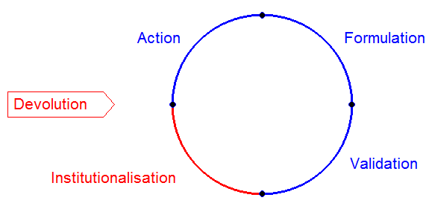
A didactical situation
(design and implementation)
Target knowledge
Didactical contract
SITUATION that preserves meaning for the target knowledge
Notes:
ACTION: The students operate on the material milieu and construct a representation of the situation that serves as a “model” that guides them in their decisions. The teacher does not intervene. The knowledge (repr. by the implicit model) has the status of a protomathematical notion (Chevallard, 1990).
FORMULATION: is where the students’ formulations are useful in order to act indirectly on the material milieu—that is, to formulate a strategy (i.e., an explicit model) enabling somebody else to operate on the milieu. Here, the teacher’s role is to make different formulations “visible” in the classroom. The status of the knowledge is that of paramathematical notions (implicit model made explicit).
VALIDATION: is where the students try to explain a phenomenon or verify a conjecture. Here, the teacher’s role is to act as a chair of a scientific debate, and (ideally) intervene only to structure the debate and try to make the students express themselves more mathematically precise. Knowledge in validation appears as mathematical notions.
INSTITUTIONALISATION: is where the teacher connects the knowledge built by the students with forms of knowledge that are socially shared, culturally embedded and institutionally legitimised.

Slide 4
Semiotic theory
Four registers of semiotic representation:
Natural language
Notation systems
Geometric figures
Cartesian graphs
Two types of transformations of semiotic representations: treatments and conversions
Duval, R. (2006). A cognitive analysis of problems of comprehension in a learning of mathematics. Educational Studies in Mathematics, 61, 103-131.

Slide 5
Two types of transformations
TRANSFORMATION
from one semiotic representation
to another
BEING IN THE SAME
REPRESENTATION REGISTER
TREATMENT
CHANGING REPR. REGISTER
but keeping reference to the same
mathematical object
  CONVERSION
Duval, R. (2006). A cognitive analysis of problems of comprehension in a
learning of mathematics. Educational Studies in Mathematics, 61, 103-131.

Slide 6
Claim
“Changing representation register is the threshold of mathematical comprehension for learners at each stage of the curriculum.”
(Duval, 2006, p. 128)

Slide 7
The study
Teacher education for primary and lower secondary education in Norway (four-year undergraduate programme)
  Data collected as part of a case study (Strømskag Måsøval, 2011)
Research question:
What conditions enable or hinder three students’ opportunity to represent a general relationship between percentage growth of length and area when looking at the enlargement of a square?

Slide 8
Methods
Research participants:
  Three female student teachers: Alice, Ida and Sophie (first year on the programme)
  A male teacher educator of mathematics: Thomas (long experience)
Data sources:
  A mathematical task on generalisation
  Video-recording of the student teachers’ collaborative work on the task, with teacher interaction (at the university campus)
Data analysis:
Task: with respect to the mathematical knowledge it aims at
Transcript: Thematical coding (Robson, 2011)
Robson, C. (2011). Real world research: A resource for social scientists and practitioner-researchers (3rd ed.). Oxford: Blackwell.

Slide 9
Reasons for choice of the episode
it provides an example of an evolution of the milieu which enabled the students to develop the knowledge aimed at
it shows the utility and complexity of changing representation register when solving a generalization task

Slide 10
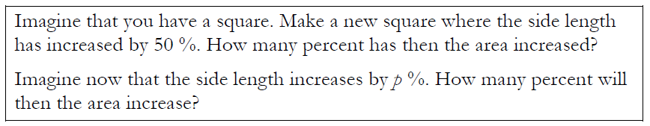
The task
Similar figures
Relationships (scaling laws) between length, area and volume:

Slide 11
The task
Percentage growth --- growth factor

Slide 12
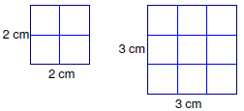
Students ’ engagement with the task
Particular case: 50 % increase of side → 125 % increase of area

Slide 13
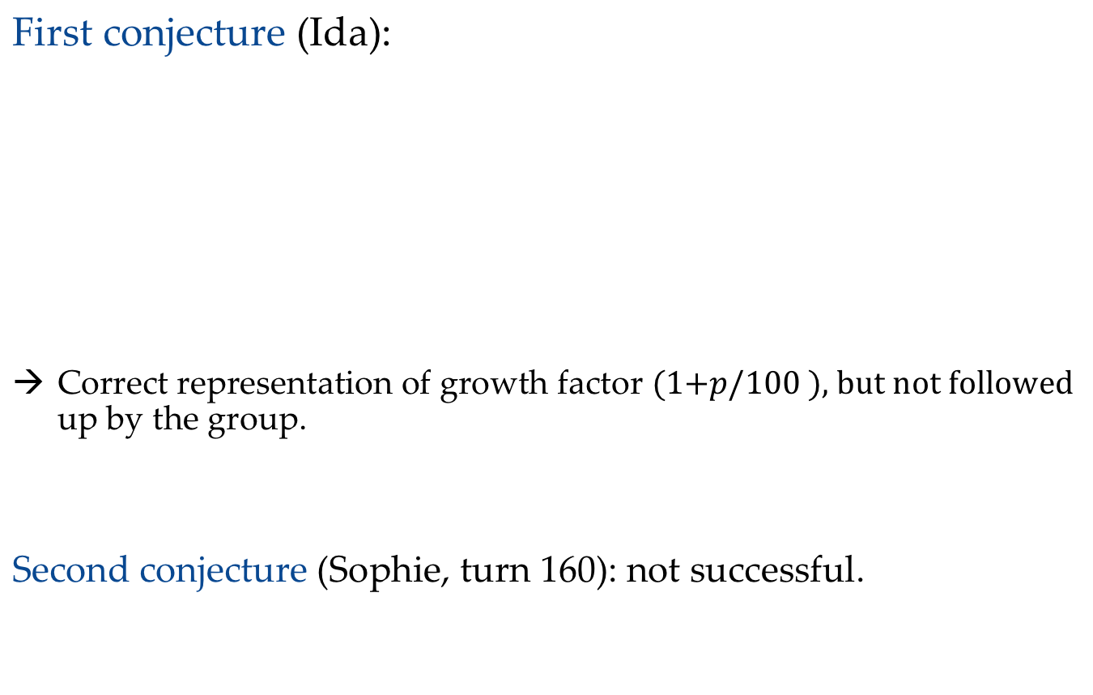
Representing a quantity enlarged by p %
First conjecture (Ida):
Correct representation of growth factor up by the group.
Second conjecture (Sophie, turn 160): not successful.

Slide 14
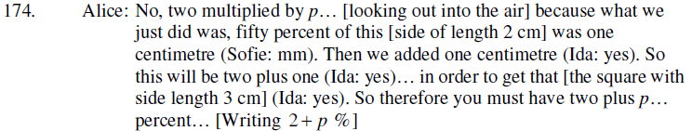
Representing a quantity enlarged by p %
Third conjecture:
2 + p % : Fails to represent that it is p percent of the
original length (“two plus p percent of two”).
Conversion is not successful.

Slide 15
adidactical situation → didactical situation
Conjecture (2.5 ∙ 𝑝 %) fails to be true for 𝑝 = 25.
→ Adidactical situation breaks down

Slide 16
The milieu changed by the teacher
50 % increase on particular cases:
squares of sizes 4 x 4, 6 x 6, 8 x 8 (cm²)
Leads to students’ conclusion:
The original square can be a unit square (1 x 1)
Seeing structure leads to student’s invention of manipulatives (paper cut-outs).

Slide 17
New material milieu shaped by Alice
Enabling enlargements to be calculated

Slide 18
The general case
They find out about the two congruent
rectangles in each case.
The small square in the upper corner
is more complicated…
Enlargement of side | Enlargement of area
50 % | 125 %
25 % | 56.25 %
10 % | 21 %
p % | ?

Slide 19
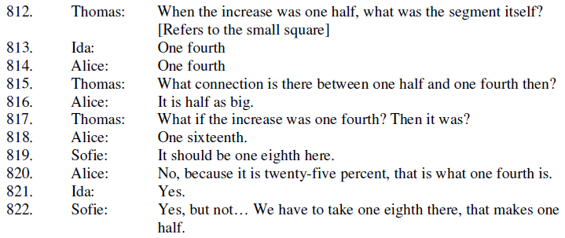
Didactic constraint due to a chosen example
Relationship between increase of side length and the area of the small square in upper corner — in fraction notation

Slide 20
Didactic constraint due to a chosen example
Relationship between increase of side length and the area of the small square in upper corner — in fractional notation
Enlargement of side | Area of small square in upper corner
 | Alice and Ida’s model (squaring) | Sophie’s model (halving)
1/2 | 1/4 | 1/4
1/4 | 1/16 | 1/8
1/5 | 1/25
1/10 | 1/100

Slide 21
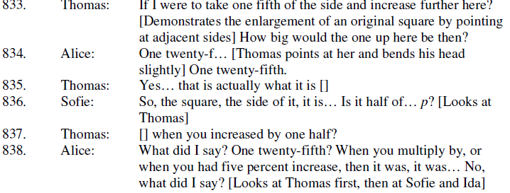
Constraint by different notation systems
(fractions – percentages)
Alice (838): increase by one fifth is mixed with five percent increase

Slide 22
conversions
Geometrical figures
Arithmetic notation
Natural language
Algebraic notation

Slide 23
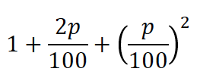
Students’ solution
Formula for the area of a 1 x 1 square as a consequence of its side length being enlarged by p %:
Justification by a generic example:
1
p/100

Slide 24
Results
Conditions that hinder the students’ solution process:
Lacking a technique for representation of growth factor
Various notation systems (percentages, decimals, fractions) and
various concepts are at stake (length, area, enlargements).
Conditions that enable the students’ solution process:
- Teacher encouraging several empirical examples:
specialising, conjecturing, generalising → seeing structure
Realizing the utility of a 1 x 1 square
Inventing paper cut-outs → change of semiotic register
Arithmetic expressions enabling algebraic thinking
Generic example (manipulatives) used to justify the formula

Slide 25
Relevance
Fine-grained analysis of transcripts of classroom communication
a detailed analysis of the functioning of knowledge and
exploration of didactic variables that can lead to its modification
  What figures to be used?
  What numbers to be used?
  What should the material milieu look like?
  What semiotic representations to be used → intended conversions?

Slide 26
Formulation → conversion
Explaining to someone else how
to operate on the material milieu
CONVERSIONS
From action: Implicit model of solution explained to someone else. Operating on the material
milieu using natural language
and other representations
Result: Explicit model of solution
Representations from
other registers (notation
systems, geometric figures,
Cartesian graphs)

Slide 27
Neuroscience
Symbols and spatial information → different areas of the brain
Mathematics learning and performance is optimized when the two areas of the brain are communicating (Park & Brannon, 2013)
Park, J., & Brannon, E. (2013). Training the approximate number system
improves math proficiency. Psychological Science, 24(10), 1–7.
Boaler, J. (2015). Mathematical mindsets. Unleashing students' potential through
creative math, inspiring messages and innovative teaching. New York: Penguin Books.

Slide 28

Thank you for your attention!

